Slide 1
Best suite in new York city

Slide 2
Why we need to find the perfect suite?
New York City received a ninth consecutive annual record of approximately 65.2 million tourists in 2018
Most of the people prefer to book their Suites through Online Platform like Airbnb.
People want to get a Suite with great surrounding and Venues of their interest.
Tourist planning to visit New York City on a tight budget , so it will be value for money.

Slide 3
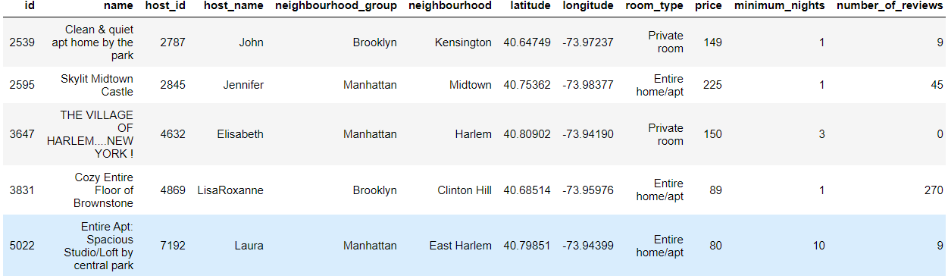
Data acquisition and cleaning
Hotels/Suite in New York City 2019, Dataset from Kaggle.com
Borough and Neighborhood in New York, Dataset from Cognitive Class.
In total, 48895 rows and 16 columns in the raw Dataset
NaN values, Zero values were Dropped and Corrected.
Cleaned data contains 48874 rows.

Slide 4
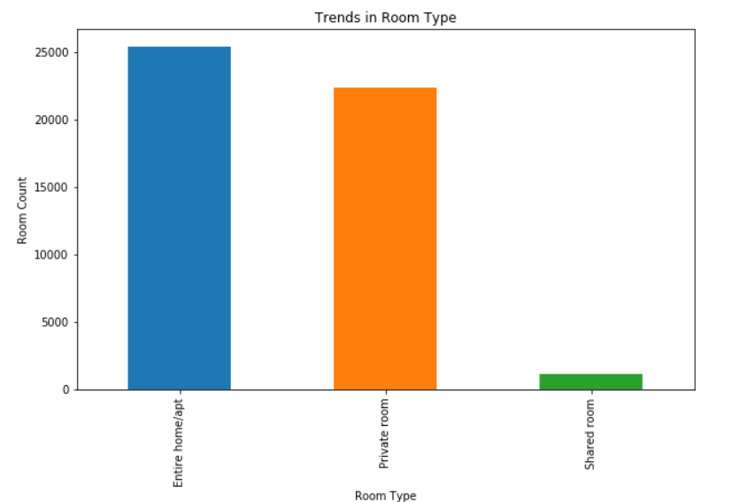
Trends in Room type
New York City has :
Entire home/apt 25400
Private room 22314
Shared room 1160

Slide 5
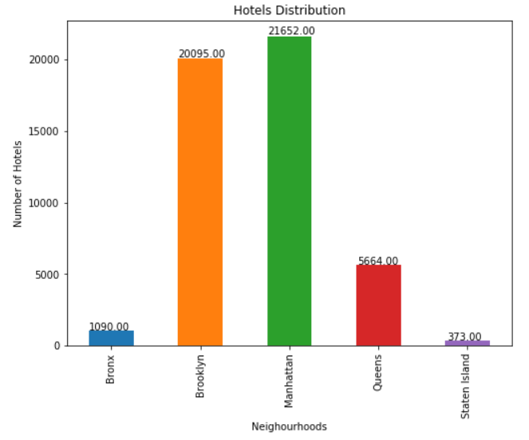
Hotels distribution
Manhattan has the most hotels in New York City.
Manhattan are well known, as New York City received a record 62.8 million tourists in 2017
Manhattan hosts three of the world's 10 most-visited tourist attractions in 2013
Analyzing the Manhattan Neighborhood would be helpful

Slide 6
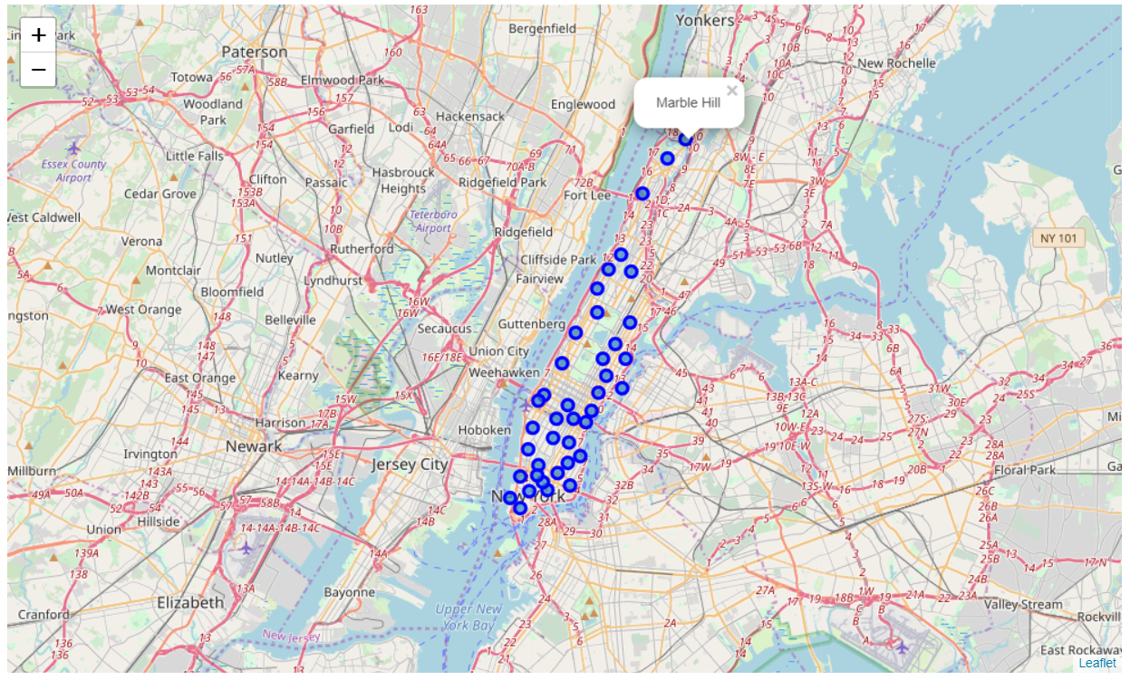
Map of Manhattan with its neighborhoods
Manhattan has 40 neighborhoods

Slide 7
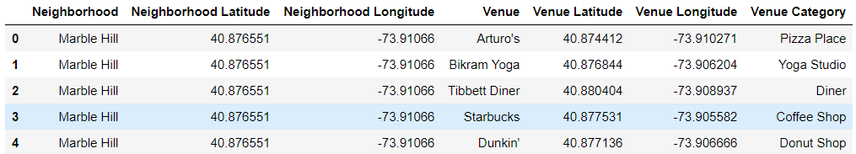
FOUrsquare Api
Foursquare was used to explore venues in each neighborhood.
Foursquare returned venues for each neighborhood within 700m.
It returned a total of 3308 venues with 309 unique venue categories

Slide 8
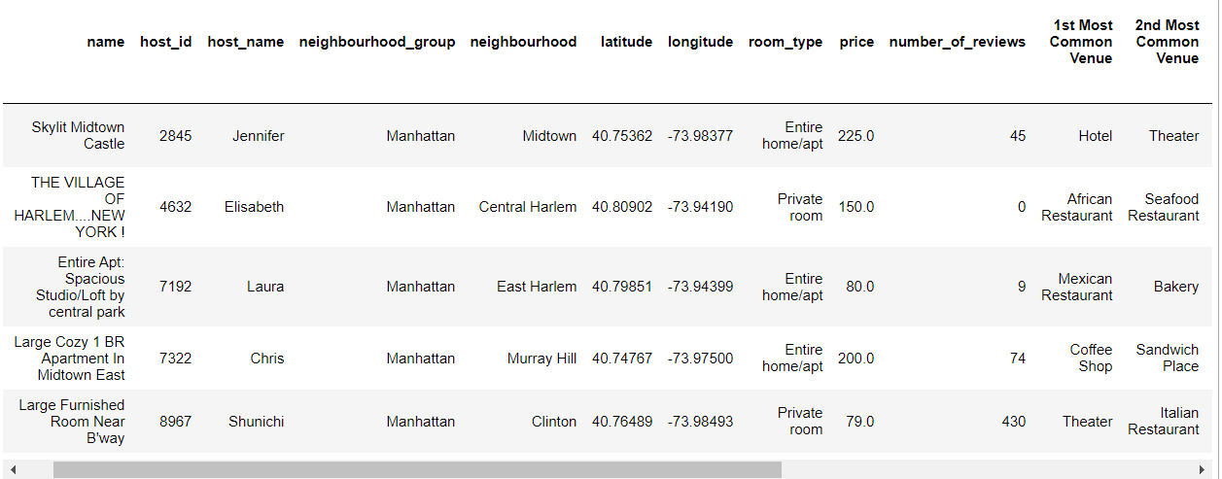
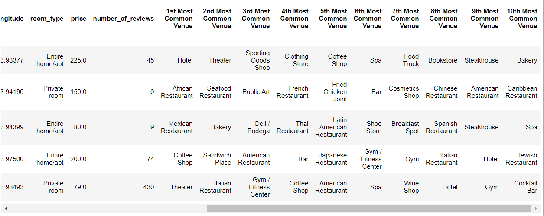
Hotels with top 10 most common venues
Data from Kaggle and Foursquare is combined to get the resulting Dataset
The final dataset contain each Hotel with its top 10 most common venues around it

Slide 9
Conclusion
As a result, most of the people prefer to book their Suites through Online Platform like Airbnb.
This information could be very helpful for users to know their place of booking, the venues around their Suites which would interest them.
Not only for users but also city managers can manage the city more regularly by using similar data analysis types or platforms.

